Slide 1




CLTV Calculation e-Commerce Project
Springboard Capstone Project 1
Dia Ganguly

Slide 2
Objective: Online Retail Customer Lifetime Value Calculation
Description
Dataset of e-commerce retail transactions in 2011
Transaction Time Frame
2011 full year
Dataset Variables:
InvoiceNo
StockCode
Description
Quantity
InvoiceDate
UnitPrice
CustomerID
Country
Number of countries 38

Slide 3
Data Visualization

Slide 4
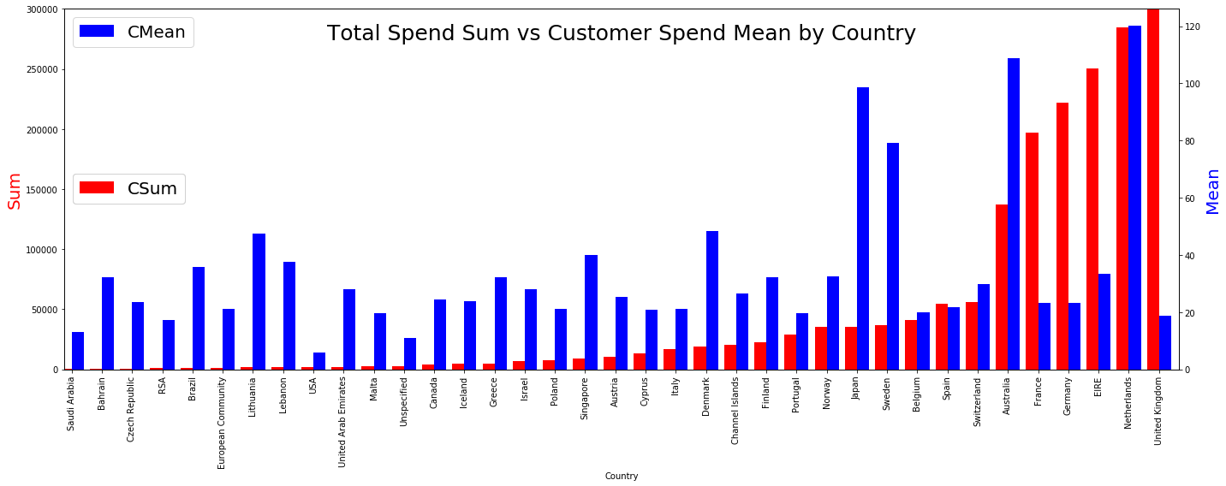
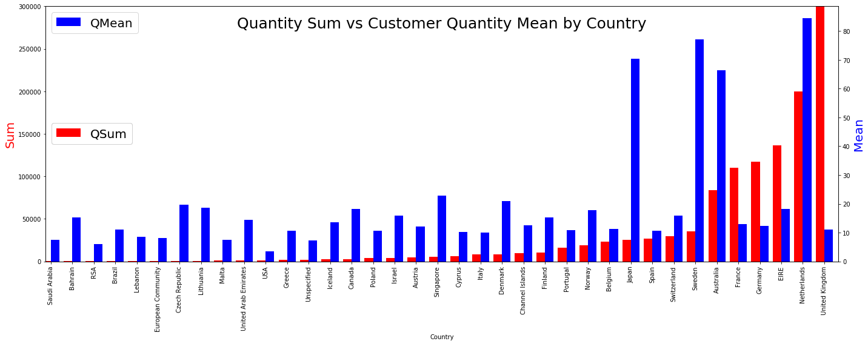
Variance by Country
Majority of the transactions and revenue are from customer in UK
Four out of the 38 countries appear to have significantly higher average customer annual spend and quantity purchased:
Japan
Sweden
Australia
Netherlands

Slide 5
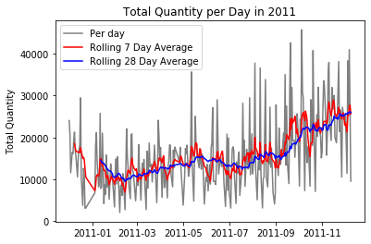
Transaction per day
Online retail data by transactions for a full year
The graph on the left indicates that sales sharply increases in November. This shows seasonality in sales.

Slide 6
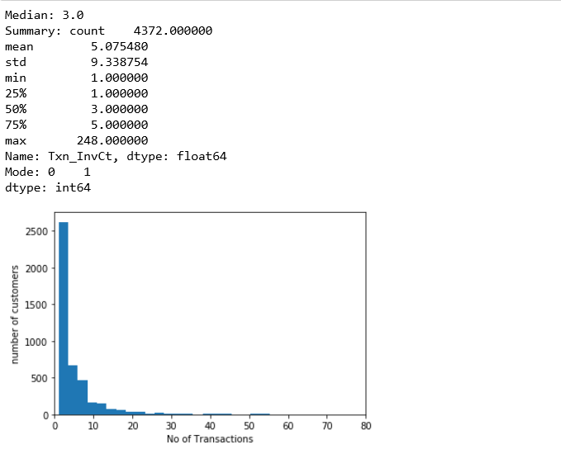
No. of Transactions
Majority of customers make one transaction
The distribution of transactions is skewed right

Slide 7
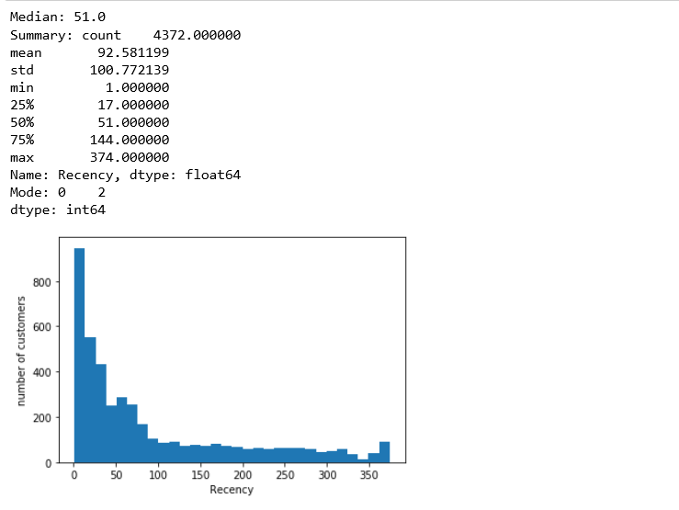
Customer Recency
Majority of customers in 2011 were active at the end of the year
The distribution of recency is skewed right

Slide 8
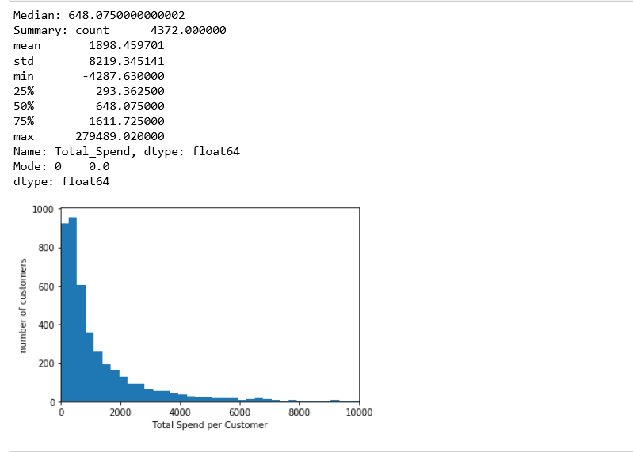
Spend for Customers
Majority of customers in 2011 were active at the end of the year
The distribution of recency is skewed right

Slide 9
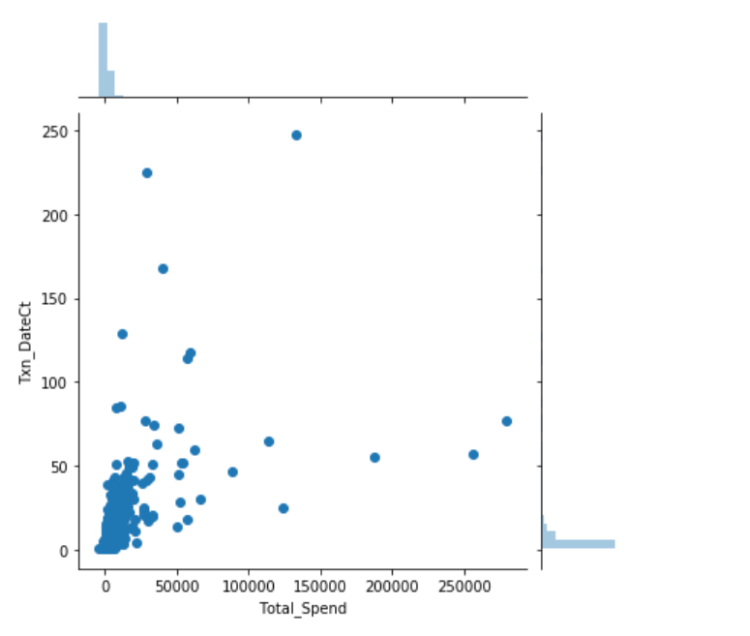
Total Customer Spend versus No. of Transaction Days
Total spend and no. of purchase days per customer is correlated.
However, there appears to be two trends. One group with higher quantity per customer with a slope that is not as steep.

Slide 10
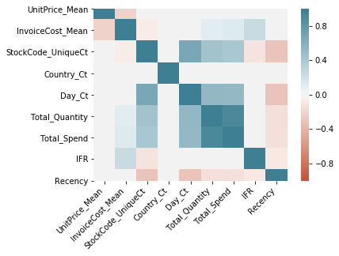
Correlation Matrix
The correlation heatmap shows strong correlation on obvious variables such as $ spend and quantity.
However, an interesting variable is between
Positive: No. of products (Count of Stock Codes) and Days
Negative: Average invoice cost and Unit Price
Therefore, we can include that higher value customer are purchasing low price items frequently, but not expensive products.

